Slide 1
TRANSIENT ERYTHROBLASTOPENIA OF CHILDHOOD by Dr. Mahadevi A.L Assistant professor Dept of Paediatrics 5-06-2021

Slide 2
Transient erythroblastopenia of childhood (TEC) is an acquired, self-limited, benign disorder characterized by a temporary suppression of erythropoiesis, resulting in reticulocytopenia in the blood and development of moderate to severe normochromic, normocytic anemia.
The most common manifestation of the anemia is pallor.
Other symptoms, such as anorexia and lethargy, may also be present.
On examination, a murmur or tachycardia may be evident.
In severe cases, hemodynamic instability may be present.

Slide 3
Physiology :
Erythroblasts are the cells that develop into red blood cells and -penia comes from the Greek word for deficiency.
Essentially, the anemia results from an inability of the bone marrow to produce red blood cells for some period of time.

Slide 4
TEC was first described in 1970.
It is the most common cause of decreased erythrocyte production in children and should be suspected in an otherwise healthy child with anemia and reticulocytopenia.
On occasion, it is preceded by an upper respiratory tract infection, although this is not seen in all cases.
TEC has been reported in siblings, and a family history increases the likelihood of the disease.
The genetic reason for this predisposition is currently unknown.
Pallor is often the only presenting symptom of TEC.
TEC is often discovered on a complete blood count that was done for some other reason.

Slide 5
The exact etiology is uncertain.
Studies suggest that TEC may be caused by certain viral illnesses, serum inhibitors against erythroid progenitor cells, and cell-mediated suppression of erythropoiesis.
Viruses that have been implicated include parvovirus B19, human herpes virus type 6, and echovirus 11; however, in most cases no virus is detected.
The incidence of TEC has been reported to be 4.3 cases per 100,000 children.

Slide 6
Risk Factors
As the name suggests, TEC occurs in childhood. The majority of children are diagnosed between one and four years of age.
Boys appear to have a slightly increased risk compared to girls.

Slide 7
The true incidence may be higher because many cases remain undiagnosed and resolve spontaneously.
The median onset occurs at 18 to 26 months, with the majority of cases occurring at 1 to 4 years of age.
TEC has been seen in all ethnicities and may be slightly more common in males than females.
No seasonal predominance is reported. Genetics may play a role in TEC, but the exact genes involved remain unknown.

Slide 8
Pathogenesis :
TEC is thought to be caused by the direct effect of viral infections or autoimmune suppression of erythropoiesis.

Slide 10
Symptoms and signs:
The anemia in TEC is a slow process so some children may have no symptoms.
These children might be found incidentally with routine blood work or may recover without ever coming to medical attention.
In other patients, symptoms are related to anemia. They include:
Fatigue or tiredness
Pallor or pale skin
Dizziness
Rapid heartbeat, known as tachycardia
Shortness of breath

Slide 11
Diagnosis
There is no single diagnostic test for TEC.
Some patients may be identified by routine blood work for well child checks.
In other patients, if anemia is suspected, TEC is identified on complete blood count (CBC).
In general, the CBC will reveal isolated anemia.
Occasionally there may be neutropenia (a decreased number of neutrophils, a type of white blood cell).
The red blood cells are normal sized but can be enlarged when the patient starts to recover.

Slide 12
The next part of the workup is a reticulocyte count.
Reticulocytes are immature red blood cells just released from the bone marrow.
Early in the course, the reticulocyte count is down, called reticulocytopenia.
Once the bone marrow suppression resolves, the reticulocyte count goes up (higher than normal) to replenish the red blood cell supply and returns to normal when the anemia resolves.

Slide 13
An extensive workup is not usually necessary, provided the MCV is normal and the blood smear does not suggest an erythrocyte disorder or leukemia.
In many cases, a CBC with differential, peripheral blood smear, and reticulocyte count are sufficient to evaluate TEC.
If the diagnosis is unclear, obtaining a bone marrow aspirate or other tests may be warranted.
CBC often reveals a normocytic, normochromic anemia with a low reticulocyte count.
Mild neutropenia may be noted in addition to a normal or slightly elevated platelet count.

Slide 14
MCV is usually low in iron deficiency; therefore, iron studies are not necessary in most cases.
Hemoglobin electrophoresis will frequently be normal, in contrast to DBA which frequently shows an elevated hemoglobin F level.
Elevated hemoglobin F levels have been reported during the recovery phase of TEC.
Erythrocyte adenosine deaminase (eADA) activity and i antigen score should be normal but are frequently elevated in DBA.
Recovery phase TEC can be differentiated from hemolysis by demonstration of a normal lactate dehydrogenase, indirect bilirubin, and haptoglobin.

Slide 16
Bone marrow aspirate can be helpful in distinguishing TEC from malignancy.
However, malignancy can often be excluded based on the absence of depression of a second cell line, or typical signs and symptoms such as bone pain, lymphadenopathy, or hepatosplenomegaly.

Slide 17
Confirming the diagnosis
There are several things to consider when differentiating TEC from other causes of anemia:
1. A patient is usually between the ages of six months to four years old.
2. Anemia usually begins around the time of birth.
3. Patient with TEC usually have normal height and no congenital anomalies.
4. The spleen is not enlarged, there are no enlarged lymph nodes, and there is no evidence of blood loss or renal dysfunction.

Slide 18
5. Lab results during the acute phase show reticulocytes as low to normal, leukocyte counts are usually normal, and platelet counts are normal to high. During recovery the reticulocyte count will be high.
6. MCV is normal accept in the recovery phase.
7. There are normal levels of folic acid, vitamin B12, serum iron, and ferritin.
8. Spontaneous recovery typically occurs in 2 months.
Imaging studies are usually not indicated for the diagnosis or management of TEC

Slide 19
Prognosis:
The prognosis for TEC is excellent.
Anemia typically persists one to two months and is followed by complete recovery.
Even though the vast majority of patients recover within 2 months, anemia can rarely last as long as one year.
Most patients spontaneously recover.
Erythrocyte transfusions are rarely needed except for patients with hemodynamic instability, exercise intolerance, or altered mental status.

Slide 20
Treatment:
Observation: If anemia is mild and your child is asymptomatic, no treatment may be necessary. Your physician may trend your child’s blood count over time until it is resolved.
Corticosteroids: Sometimes steroids like prednisone have been used but there is no solid evidence that this treatment shortens the time to recovery.
Transfusion: If the anemia is severe or your child is symptomatic from the anemia (dizziness, fatigue, shortness of breath, elevated heart rate, etc.) a blood transfusion may be given.

Slide 21
In most cases, spontaneous resolution occurs in two to eight weeks without intervention.
Observation is sufficient in most cases, and erythrocyte transfusion is rarely needed except when there is hemodynamic instability or interference with quality of life.
Because observation is the mainstay of treatment, there are typically no adverse effects.
In cases where transfusion is necessary, hemolytic, allergic and infectious transfusion-related reactions may occur.

Slide 22
Complications :
Due to the benign and transient nature of TEC and spontaneous resolution within two months, there are typically no complications.
If the anemia is severe enough, TEC may produce symptoms requiring a blood cell transfusion, although this is rare.

Slide 23
Prevention
Because the cause of TEC in an individual patient varies and cannot be predicted, there are no ways to prevent TEC.

Slide 24
COMPARISON OF DIAMOND-BLACKFAN ANEMIA AND TRANSIENT ERYTHROBLASTOPENIA OF CHILDHOOD
Feature | DBA | TEC
Male : female | 1 : 1 | 1 : 3
AGE AT DIAGNOSIS, MALE (mo)
Mean | 10 | 26
Median | 2 | 23
Range | 0-408 | 1-120
AGE AT DIAGNOSIS, FEMALE (mo) Mean Median Range Boys >1 yr Girls >1 yr Etiology Antecedent history | 14 3 0-768 9% 12% Genetic None | 26 23 1-192 82% 80% Acquired, possibly familial Viral Illness

Slide 25
Feature | DBA | TEC
Physical examination abnormal (congenital anomalies present) | 25% | 0%
LABORATORY Hemoglobin (g/dL) WBCs <5,000/μL Platelets >400,000/μL Adenosine deaminase MCV increased at diagnosis MCV increased during recovery MCV increased in remission HbF increased at diagnosis HbF increased during recovery HbF increased in remission | 1.2-14.8 15% 20% Increased 80% 100% 100% 100% 100% 85% | 2.2-12.5 20% 45% Normal 5% 90% 0% 20% 100% 0%
i Antigen increased i Antigen increased during recovery i Antigen increased in remission | 100% 100% 90% | 20% 60% 0%

Slide 28
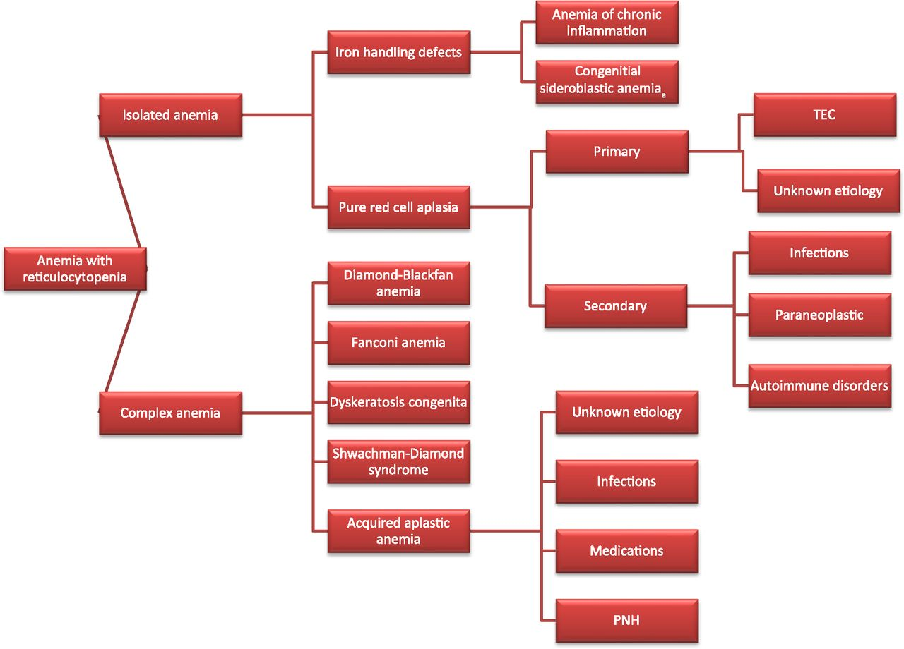

Slide 29
Differential Diagnosis
Acute Lymphoblastic Leukemia (ALL)
Anemia of Prematurity
Aplastic Anemia
Chronic Anemia
Diamond-Blackfan anemia
Drug-induced anemia
Leukemia
Parvovirus B19 Infection

Slide 30
Thank u

